Slide 1
So You Think You Know MLA Formatting …
August 2012
Andii Johnson

Slide 2
When editing for MLA format, look at the page in a big picture frame of mind. Are the margins right? Is the header right? How does the “Works Cited” page look?
Before reading a paper for content, read it for formatting.
Find the MLA formatting error(s) in the following slides.

Slide 3
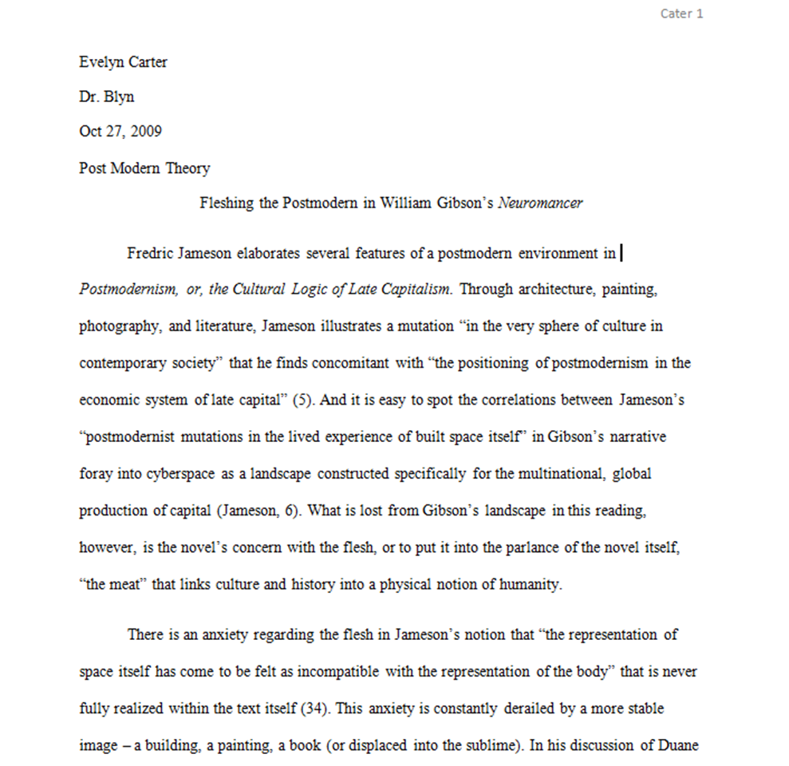
Heading is out of order
Student’s last name is misspelled
Use MLA format for date
Extra spacing
Unnecessary comma in parenthetical citation

Slide 4
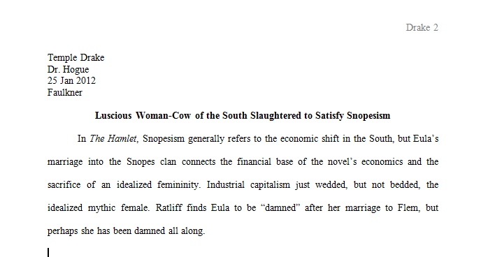
Incorrect page number
Double space heading
Do not bold title
Text should be aligned left, not justified

Slide 5
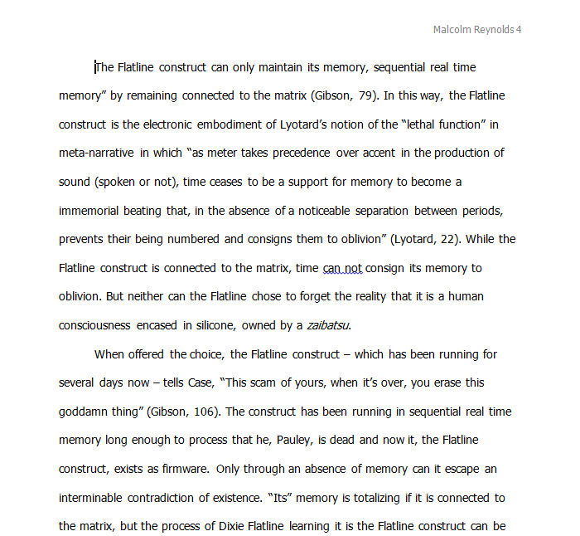
Use last name and page number only
This font is not New Times Roman.
Unnecessary commas in parenthetical citations

Slide 6
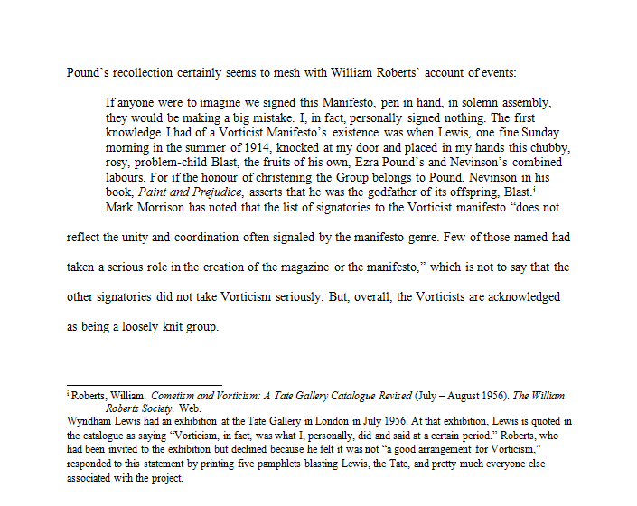
Missing header
Block quotes should be indented one inch and double spaced.
There should be one double space between the end of the quote and the next line of text.

Slide 7
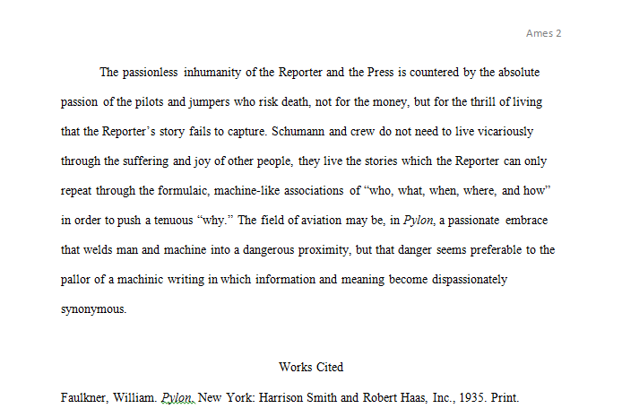
While some instructors and professors do allow students to take liberties with MLA formatting, do not assume it is alright for students to place their “Works Cited” page on the last page of text. As with other spacing and pagination issues, mention it and mark it.

Slide 8
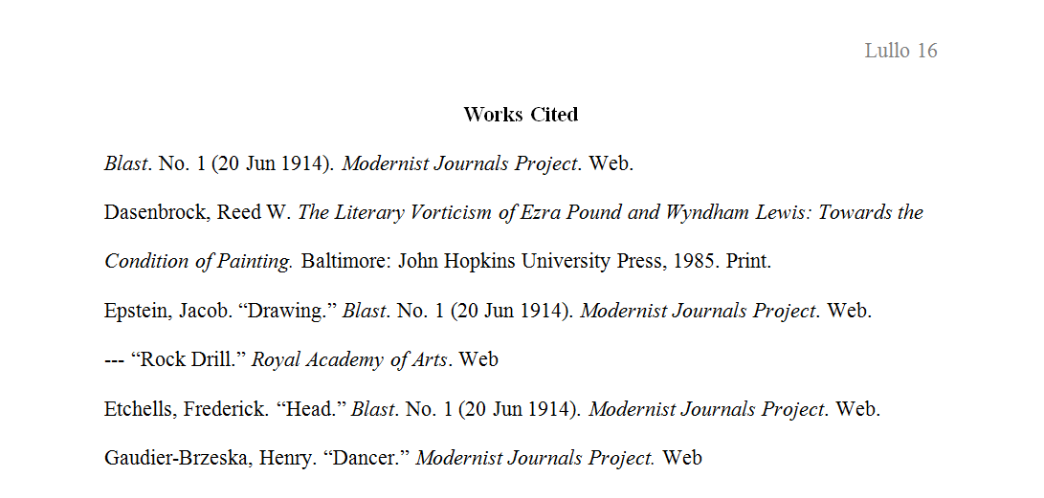
Do not bold “Works Cited.”
The second and all subsequent lines of the citation should have a hanging indent.
Missing periods

Slide 9
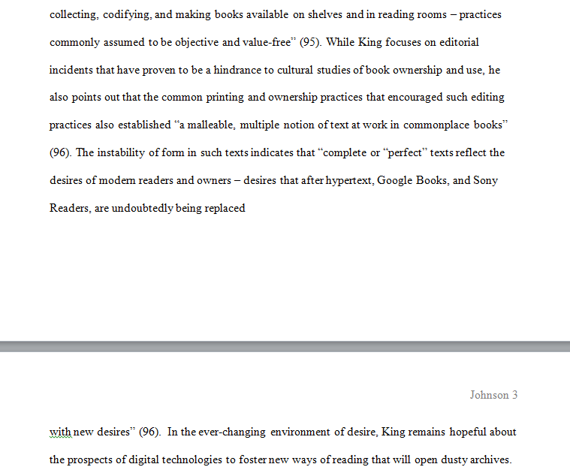
Ensure that pages end and begin logically.

