Slide 1
Business Letter Formats Mini-Lesson #20
Created by Benjamin LaVictoire
April
2012

Slide 2
Different Formats
In the United States, there are three major letter formats that are commonly used.
Block format
Modified block format
Simplified format

Slide 3
These formats differ in. . .
The way paragraphs are indented
The way letter parts are placed
And in some punctuation

Slide 4
Block Format
Block format is designed not only for quick and efficient preparation, but also for quick and easy reading.
According to block format, each letter part should be aligned to the left.

Slide 5
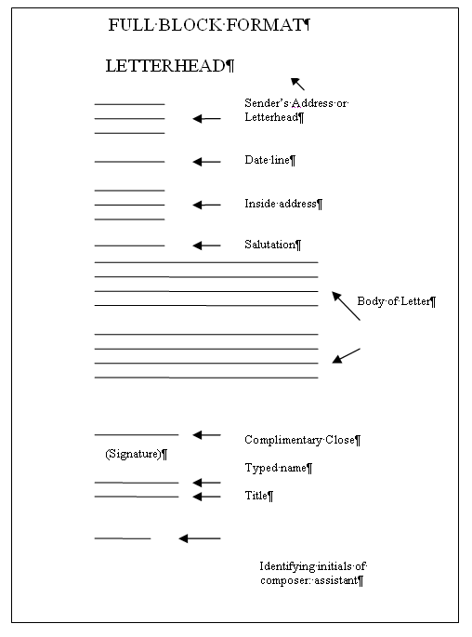
Example of Block Format
The date and the inside address should be separated by 2 blank spaces.
Every other component between the salutation and the complimentary close should receive 1 full blank space of separation.
Finally, there should be 3 spaces between the complimentary close and the signature block.

Slide 6
Modified Block Format
Modified block format is very similar to block format. Modified block format mixes preparation speed with traditional placement of some letter parts. This format also looks more balanced on the page than block format does.

Slide 7
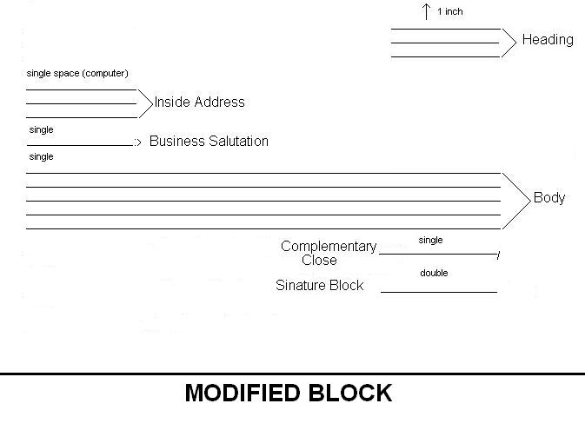
Example of Modified Block Format
Modified block format is very similar to block format. However, the date, complimentary closing, and signature block begin toward the middle of the page.
Modified block also allows for optional paragraph indention.

Slide 8
Simplified Format
Unlike block and modified block, simplified format does not include a salutation. The recipient’s name will typically be worked into the first sentence of the letter. Also, simplified format does not include a complimentary closing. The signature comes immediately after the body of the letter followed by the printed name which will typically be in all capital letters.

Slide 9
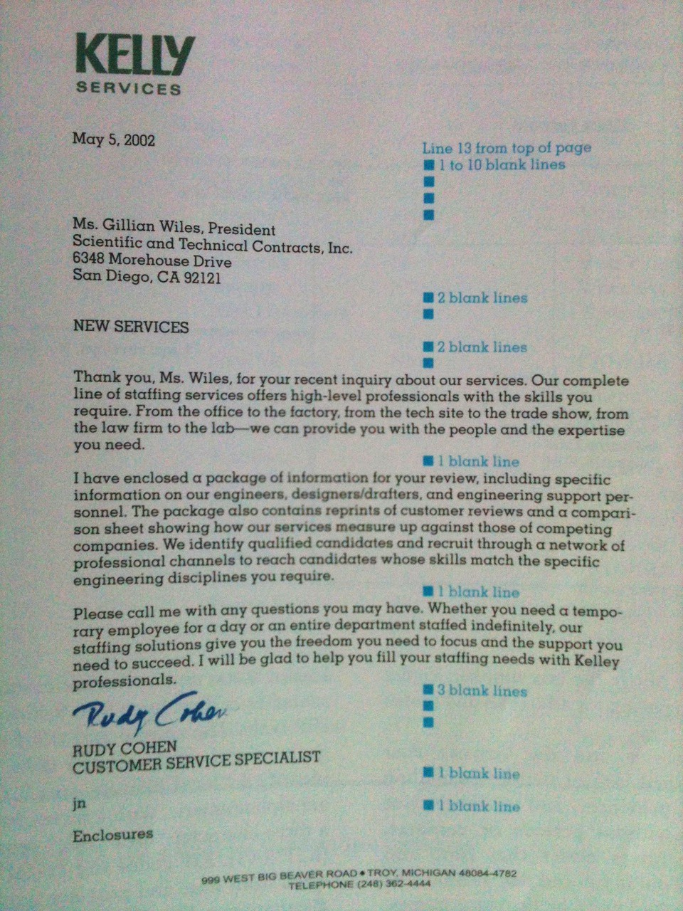
Example of Simplified Format
Like block format, simplified format has each letter part aligned to the left.

Slide 10
Which format to choose
When choosing a letter format, take into account who your audience is and what the purpose of the letter will be.
For example, because of its impersonal nature, simplified format is typically used when the audience is unknown to the writer.

Slide 11
Notes
Though these three formats are different, they do share some similar patterns.
The different letter parts are always separated by at least one full line.
The printed name is always separated from the line above by at least three blank lines to allow room for a signature.

Slide 12
Other Sources
Business Communication Today, 7th edition, 2003
Contemporary Business Communication, 1992

